Slide 1


Policy Search Integration
criteria
13 November 2013
Notes:
Guidewire training materials contain Guidewire proprietary information that is subject to confidentiality and non-disclosure agreements. You agree to use the information in this manual solely for the purpose of training to implement Guidewire software solutions. You also agree not to disclose the information in this manual to third parties or copy this manual without prior written consent from Guidewire. Guidewire training may be given only by Guidewire employees or certified Guidewire partners under the appropriate agreement with Guidewire.
Policy Search Integration - <number>

Slide 2
Lesson objectives
By the end of this lesson, you should be able to:
  Describe the three main integration points between ClaimCenter and the Policy Administration Systems
  Implement the policy search integration point
  This lesson uses the notes section for additional explanation and information.
  To view the notes in PowerPoint, choose View→Normal or View→Notes Page.
  If you choose to print the notes for the lesson, be sure to select “Print hidden slides.”
Notes:
Policy Search Integration - <number>

Slide 3
Lesson outline
PAS integration points
Implementing policy search integration
Policy search example
Notes:
Policy Search Integration - <number>

Slide 4
PAS integration
Every instance of ClaimCenter must be integrated with one or more Policy Administration Systems
There are three required integration points:
search
criteria
policy search
policy retrieval
Policy
Admin
System
policy refresh
Notes:
Policy search and policy retrieval are required to create claims. Without this functionality, there would be no way for ClaimCenter to have an understanding about the covered losses against which the claim is to be filed.
Policy refresh is not required to create a claim, but in some cases it is required to efficiently adjudicate a claim. This is because the policy may change after the claim is created, and those changes could be relevant to the claim. (For example, the covered object and/or coverages on that object may have been omitted inadvertently from the policy.) Without policy refresh, the adjuster must often resort to complex work-arounds that reduce their efficiency and increase the risk that the claim will be improperly processed.
Policy Search Integration - <number>

Slide 5
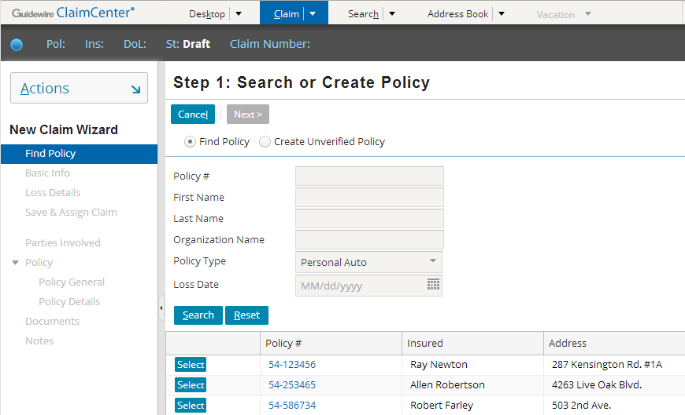
Policy search
search
criteria
During policy search, the PAS is queried for summaries of policies that meet the user-specified criteria
Notes:
Policy search occurs on the first step of the New Claim wizard. It consists of taking the search criteria entered by the user (such as "PolicyType = Personal Auto" in the example above), querying the PAS for policies matching the criteria, and then displaying the search results for the user (such as the three Personal Auto policies displayed in the example above).
Each of the search results is a policy summary. Policy search can return zero to many policy summaries.
Policy Search Integration - <number>

Slide 6

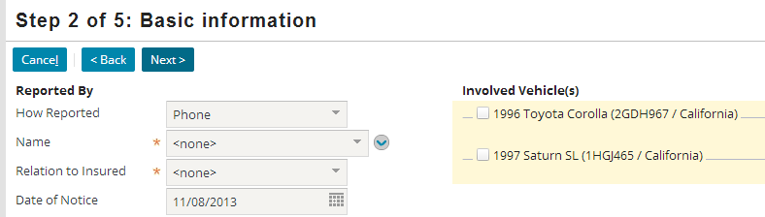
Policy retrieval
During policy retrieval, a selected policy and the information contained in it are copied from the PAS to ClaimCenter
Notes:
Policy retrieval occurs between the first and second steps of the New Claim wizard. It consists of retrieving a full copy of the policy selected by the adjuster in step 1 of the New Claim wizard and then mapping the data in that policy to the ClaimCenter data model. For example, as shown above, the adjuster selects the summary for policy 54-123456 in Step 1. Between steps 1 and 2, the entire policy is retrieved and loaded into ClaimCenter. This includes the insured's name, address, primary phone number, and the vehicles listed on the policy.
Policy retrieval should always return exactly one policy.
Policy Search Integration - <number>

Slide 7
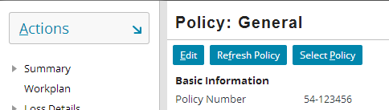
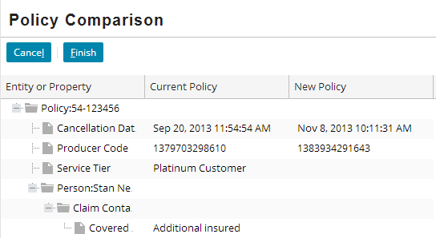
Policy refresh
During refresh, a policy is re-retrieved from the PAS, and may include changes made after the policy was first retrieved
Notes:
Policy refresh is a process that the adjuster can do after the claim has been created. When executed for a given claim, the policy is re-retrieved from the PAS and potentially re-linked to the claim.
There are several situations in which an adjuster may need to refresh a policy:
When the claim was created, the wrong loss date was reported or entered. This caused the wrong policy period to be retrieved from the PAS.
The policy has multiple vehicles or properties on it, and the adjuster selected the wrong subset of vehicles or properties to copy over to the claim. Therefore, the copy of the policy in ClaimCenter lacks a vehicle or property relevant to the claim.
The policy had an error on it, such as a risk unit or coverage that was inadvertently left off of the policy. The error has now been corrected in the PAS.
The policy could not be found during intake, so the adjuster used an unverified policy.
In the example above, the policy for a given claim is being re-retrieved. Between the initial creation of the claim and the time of refresh, several aspects of the policy have changed, including:
The cancellation date.
The producer code.
The Honda GX (which was originally on the policy but is no longer on the policy).
The person Allen Robertson (who was not on the original policy but is on the policy now).
The role of Karen Egertson (the role of "Covered Party" was added to her on the PAS policy since the claim was created).
Policy Search Integration - <number>

Slide 8
Integration points needed by the PAS
The PAS may require information from ClaimCenter about:
  Large loss notification – the PAS may need to be informed of claims that exceed a certain value
    The value may be global or based on line of business
  Risk analysis during policy renewal – the PAS may need to know about claims filed against a policy which is up for renewal
  Reinsurance – a business practice in which one carrier shares the responsibility to cover a loss with another carrier
Notes:
Large loss notification: Reasons for this could include:
The policy underwriter or the loss control department may need to order special loss prevention services when a large loss occurs.
The policy underwriter may want to know about a claim with a large loss before the producer of the policy contacts the underwriter about the claim.
The large loss could indicate mis-classification or fraud, both of which require mid-term action by the underwriter.
If this requirement exists, then ClaimCenter should alert the PAS whenever a claim is created whose reserves match or exceed that threshold. The screenshot in the upper right corner is from Guidewire PolicyCenter, which is a PAS. It shows an activity pertaining to a large loss that was created based on information from ClaimCenter.
Risk analysis during policy renewal: If the policy is considered to be risky (which could happen if one or more claims have been filed against it), then the premium for the policy could go up at renewal time. Risk analysis is almost entirely a PAS integration point. The only thing ClaimCenter does is provide information about claims associated to a given policy. The screenshot in the lower right corner shows the Guidewire PolicyCenter Risk Analysis screen, and in particular the tab used to query ClaimCenter for information about claims filed against the given policy.
Reinsurance: The nature of the shared responsibility depends upon the agreement that the carrier has with the additional carrier, and it could possibly be for losses over a certain fixed amount or for a percentage of a given loss. If a carrier has reinsurance agreements with other carriers, then the PAS must be informed when a claim is filed and some portion of the responsibility to pay the claim must be passed on to the other carrier.
This course does not discuss large loss notification, risk analysis, or reinsurance in detail. For more information on large loss notification and reinsurance, refer to the ClaimCenter Integration Guide. For risk analysis, refer to the documentation associated to the PAS.
Policy Search Integration - <number>

Slide 9
The Policy entity
ClaimCenter
Policy Admin
System
Claim
000-00-027
Claim
000-00-028
Claim
000-00-029
In the ClaimCenter data model, a policy is a "snapshot" copy of the full PAS policy
  Each claim has its own policy object, even when multiple claims are filed against the same PAS policy
  Changes in the PAS are not automatically reflected in CC
Notes:
Changes in the PAS policy are copied over to ClaimCenter only when the policy is refreshed.
Policy Search Integration - <number>

Slide 10
The PolicySummary entity
policy
summary
full policy
A policy summary is a virtual entity containing a subset of information about a policy
  Typically includes summary data (policy number, insured name, effective and expiration date)
  Typically does not include detailed data (coverages, deductibles, limits)
Used to facilitate high-performance policy searches
Notes:
Policy Search Integration - <number>

Slide 11
Plugins for PAS integration
Policy search
search
criteria
Policy retrieval
IPolicySearch
Adapter
Policy refresh
IPolicyRefresh
Plugin
Notes:
There are two plugins for the integration points required by ClaimCenter:
IPolicySearchAdapter has methods for policy search and policy retrieval. (It also has a method for policy refresh, but Guidewire recommends that you implement policy refresh using the IPolicyRefreshPlugin plugin.)
IPolicyRefreshPlugin contains the methods for policy refresh.
There are additional plugins for integration points that may be required by the PAS:
IPolicySystemNotificationPlugin contains the methods to execute large loss notification.
IReinsurancePlugin contains the methods to execute reinsurance.
Risk analysis at policy renewal is an "inbound" integration point initiated by the PAS. Therefore, there is no plugin that corresponds to this integration point.
Policy Search Integration - <number>

Slide 12
Lessons for PAS integration
Policy search
(remainder of this lesson)
search
criteria
Policy retrieval
(Retrieval lesson)
Policy refresh
(Refresh lessons)
Notes:
Policy search is discussed in detail in the remainder of this lesson.
Policy retrieval is discussed in the "Policy Retrieval Integration" lesson.
Policy refresh is disussed in three lessons:
"Introduction to Policy Refresh"
"Policy Refresh Integration: The Data Model"
"Policy Refresh Integration: The User Interface"
Policy Search Integration - <number>

Slide 13
Lesson outline
PAS integration points
Implementing policy search integration
Policy search example
Notes:
Policy Search Integration - <number>

Slide 14
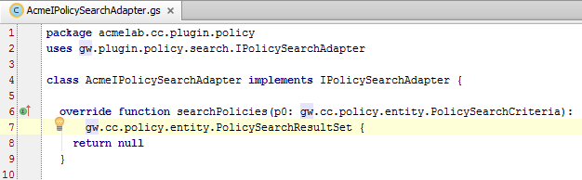
The IPolicySearchAdapter interface
Includes the searchPolicies() method, which makes use of these entities:
  PolicySearchCriteria
  PolicySummary
  PolicySearchResultsSet
Notes:
The interface for the policy search-and-retrieval plugin is:
Gosu: gw.plugin.policy.search.IPolicySearchAdapter
Java: com.guidewire.cc.plugin.policy.search.IPolicySearchAdapter
The IPolicySearchAdapter has four methods:
searchPolicies(), which is used for policy search and is discussed in this lesson.
retrievePolicyFromPolicySummary(), which is used for policy retrieval and is discussed in the "Policy Retrieval Integration" lesson.
retrievePolicyFromPolicy(), which was a method formerly used to implement policy refresh. Implementation of this method is no longer recommended, Instead, one should configure the gw.plugin.policy.refresh.PolicyRefreshConfigurationBase class as described in the Policy Refresh lessons.
retrievePolicySummaryFromPolicy(), which is used by policy refresh for the Commercial Property and Commercial Auto lines of business. When a claim is initially created for these lines of business, the adjuster is shown a list of the properties/vehicles on the policy summary (of which there could be tens or hundreds) and allowed to select the subset of properties/vehicles relevant to the claim. Only the selected subset are copied over when the policy is retrieved. If the policy is later refreshed, the adjuster must once again have a chance to select the subset of relevant properties/vehicles from the policy summary, which means the policy summary must be re-retrieved before the policy itself is re-retrieved. The re-retrieval of the policy summary is executed by this method.
Policy Search Integration - <number>

Slide 15
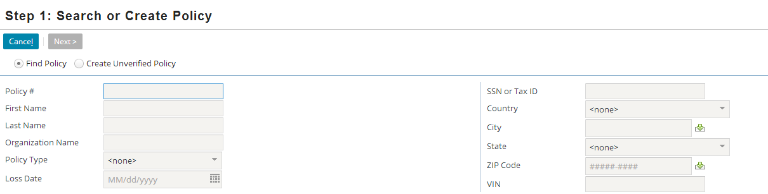
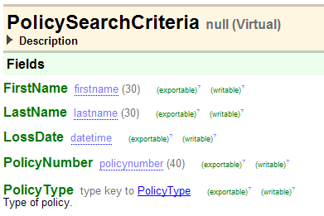
The PolicySearchCriteria entity
PolicySearchCriteria is a virtual entity used to gather search criteria, typically from the user interface
  Developers can extend the entity if they want to enable searches on fields not found in the base application
Notes:
Search criteria entities are virtual entities. This means that they have no underlying table in the ClaimCenter database. Rather, they are non-persistent and only exist within the session in which you use them. For information on extending virtual entities, refer to the ClaimCenter Configuration Guide.
Policy Search Integration - <number>

Slide 16
Non-uniqueness of policy number
There can be multiple policies (and therefore multiple policy summaries) with the same policy number
  This typically occurs with renewed policies that are effective for different periods of time
Insurance carriers can take other approaches for how policy numbers are treated during renewal
  Issue new numbers at renewal
  Use a single number but append a different suffix to each policy period
When planning PAS integration, determine the way policy numbers map to policies
  This should be done early
Notes:
Policy Search Integration - <number>

Slide 17
Searches based on loss date
Searches can return multiple policy periods for the same policy
  If Loss Date is included, then only policy periods active on that date should be returned
When a loss date is provided, then whenever possible, the PAS should handle exclusion of policies not effective during the loss date
  Results in fewer policy summaries sent across the network
  If the PAS cannot do this, then it can be done in ClaimCenter
Notes:
Policy Search Integration - <number>

Slide 18
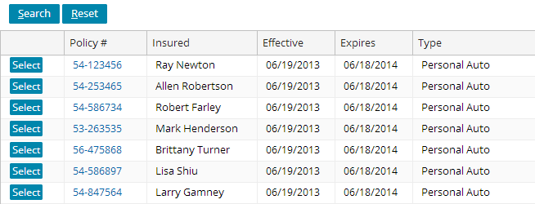
Entities used in policy searches
PolicySummary is a summary of one policy meeting the PolicySearchCriteria's search criteria
PolicySearchResultSet is an entity primarily composed of a single array of PolicySummary instances
Notes:
PolicySummary is an entity that contains all of the fields that either:
May be needed as search criteria, and/or
May be needed to display in the search results to help the user identify the correct policy
PolicySummary is also a virtual entity that can be extended if necessary.
Aside from fields used for internal processing, PolicySearchResultSet has two fields and one array:
ResultsCapped - A Boolean that is true if and only if the results of the search have been capped, that is, if fewer results are contained in this result than actually satisfied the search criteria.
UncappedResultCount - An integer that returns the total number of matches that would have been returned had the results not been capped, or null if the value is unknown. This is typically relevant only if ResultsCapped is true. (The value could conceivably be used for an uncapped result if it were desirable to know the count. For example, if the UI was modified to include labels such as "Showing results 26-50 out of <UncappedResultCount>".)
Summaries - An array of PolicySummary instances.
Policy Search Integration - <number>

Slide 19
Steps to search for policies
Transform the data from the PolicySearchCriteria into a format that the PAS can understand
Send the criteria to the PAS, and receive the results
Perform any addtional filtering on the results (if needed)
Map the final results into an array of PolicySummary instances
Notes:
Policy Search Integration - <number>

Slide 20
Lesson outline
PAS integration points
Implementing policy search integration
Policy search example
Notes:
Policy Search Integration - <number>

Slide 21
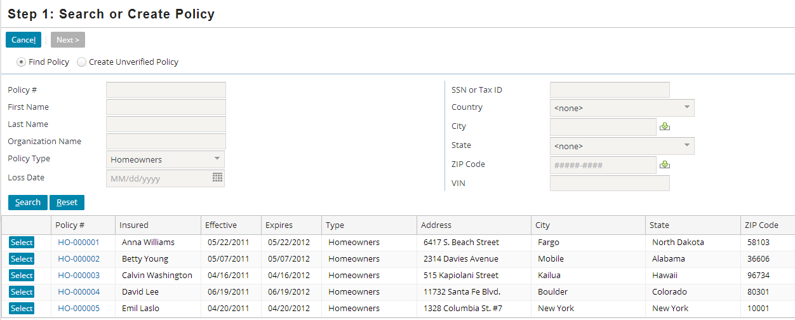
Search example for homeowners
The following slides walk through a sample implementation of policy search against ExternalApp for the Homeowners line of business
Notes:
You can make this example function in ClaimCenter. To do this, you must:
Load the AcmeIPolicySearchAdapter files into ClaimCenter. (Information about this is included in the lab.)
Have ExternalApp running.
Policy Search Integration - <number>

Slide 22
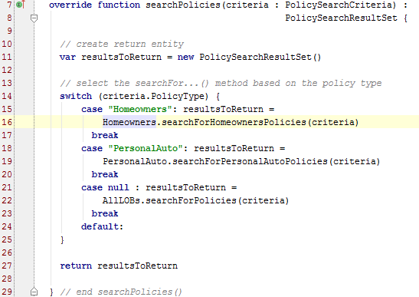
Step 0: Call LOB-specific search method
The policy search example uses separate methods for searching based on the search criteria's line of business
Notes:
If a single PAS is used for all policies, and if the data needed for policy search is roughly the same for each line of business, then a single searchPolicies() method may be usable. If multiple PASs must be queried, or if the search results differ significantly from one line of business to the next, then it may be easier to have multiple search methods, each of which is called from searchPolicies() as needed.
In the sample integration point, the PAS policy search APIs are all LOB-specific. If the user wants to do a search across all LOBs, then one search must be executed for each LOB, and the results must be combined. The code for this appears in acme.cc.plugin.policy.AllLOBs.searchForPolicies(). In the actual code, lines 23 includes a call to this method. Due to limited space, this call has been omitted from the slide above.
Policy Search Integration - <number>

Slide 23

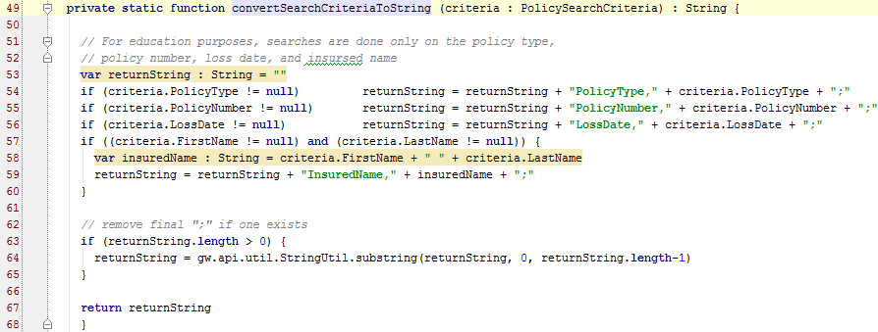
Step 1: Transform data to PAS format
The web service that searches for homeowner policies requires a
semicolon-delimited list of name/value pairs.
Notes:
In the scenario above, the PAS requires that the search criteria be a string of name/value pairs that are delimited by semicolons (such as "PolicyNumber,00-000001;InsuredName,Anna Williams"). The private convertSearchCriteriaToString() method simply takes all the criteria in the PolicySearchCriteria object and converts them to name/value pairs. (For instructional purposes, many fields in the PolicySearchCriteria have been omitted from the code.)
Note that the data as understood by ClaimCenter must be converted to a format the PAS can understand. For example, the PolicySearchCriteria stores first name and last name as separate fields, but the PAS requires a single "InsuredName" field to be submitted to it.
Policy Search Integration - <number>

Slide 24
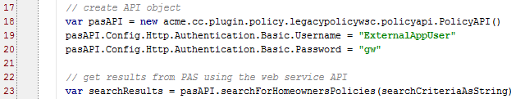
Step 2: Send criteria and receive results
In this example, the PAS receives and processes queries using a PolicyAPI web service
The code:
  Creates an API object
  Calls the "searchForHomeownersPolicies() method
  Stores the results in an object named "searchResults"
Notes:
In the scenario above, the results are returned is an array of objects of type PASHomeownersPolicySummary, which is a type constructed in Gosu based on the web service collection WSDL.
Policy Search Integration - <number>

Slide 25
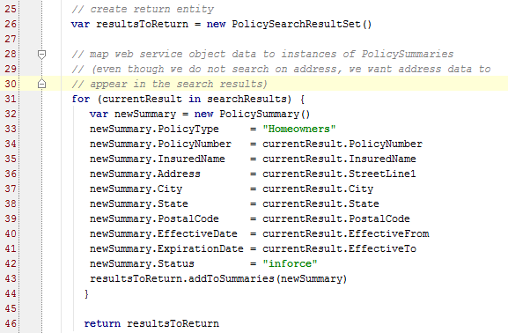
Step 3: Further filter results, if necessary
Step 4: Map results to PolicySummary array
Notes:
In the scenario above, there is no need for further filtering of the results.
In the scenario above, a for loop is used to iterate through the searchResults array (which is an array of PASHomeownersPolicySummary). For each instance of PASHomeownersPolicySummary, a new PolicySummary is created and the data in the PASHomeownersPolicySummary is copied to the PolicySummary. Then, the PolicySummary is added to the resultsToReturn.Summaries array. Finally, the resultsToReturn object is returned.
Note the following, which are examples of the complexity that can be involved in PAS integration:
ClaimCenter uses the code "Homeowners" for homeowners policies, but the PAS uses the code "Homeowner's". Because the two codes do not match (and because all policy summaries returned by this method are homeowners policy summaries), the summary's PolicyType field is populated with the ClaimCenter code (line 34).
The PASHomeownersPolicySummary object has fields that correspond to ClaimCenter PolicySummary fields, but the field names do not always match. For example, PASHomeownersPolicySummary has date fields called "EffectiveFrom" and "EffectiveTo", but ClaimCenter names the fields "EffectiveDate" and "ExpirationDate" (lines 41-42).
Policy Search Integration - <number>

Slide 26
Results as seen by the end user
This example shows summaries of policies from the external PAS
Notes:
Policy Search Integration - <number>

Slide 27
Lesson objectives
You should now be able to:
  Describe the three main integration points between ClaimCenter and the Policy Administration Systems
  Implement the policy search integration point
Notes:
Policy Search Integration - <number>

Slide 28
Review questions
What are the three required integration points for ClaimCenter/PAS integration?
A claim is created in January using a given PAS policy. A new claim is created in February using the same PAS policy. In March, the PAS policy is modified. As of April:
  Does the policy on the first claim match the PAS policy?
  Does the policy on the first claim match the policy on the second claim?
If a user includes Loss Date in policy search criteria, how should the value be used when searching for policies?
What are the four primary steps of the searchPolicies() method?
Notes:
Policy Search Integration - <number>
Answers
1. Policy search, policy retrieval, policy refresh.
2. a) No (unless the policy on the first claim is refreshed after the PAS policy was modified).
b) Possibly. If the PAS policy was not modified from January to February, then the two policies would be logically identical. However, there is nothing in ClaimCenter that enforces this.
3. If Loss Date is included in the search criteria, then only policies that are effective during the given Loss Date should be returned.
4. a) Transforming the data from the PolicySearchCriteria into a format that the PAS can understand.
b) Sending the criteria to the PAS, and receiving the results.
c) Filter the results, if necessary.
d) Transforming the results into a set of PolicySummary instances.

Slide 29
Notices
Copyright © 2001-2013 Guidewire Software, Inc. All rights reserved.
Guidewire, Guidewire Software, Guidewire ClaimCenter, Guidewire PolicyCenter, Guidewire BillingCenter, Guidewire Reinsurance Management, Guidewire ContactManager, Guidewire Vendor Data Management, Guidewire Client Data Management, Guidewire Rating Management, Guidewire InsuranceSuite, Guidewire ContactCenter, Guidewire Studio, Guidewire Product Designer, Guidewire Live, Guidewire DataHub, Guidewire InfoCenter, Guidewire Standard Reporting, Guidewire ExampleCenter, Gosu, Deliver Insurance Your Way, and the Guidewire logo are trademarks, service marks, or registered trademarks of Guidewire Software, Inc. in the United States and/or other countries.
Guidewire products are protected by one or more United States patents.
Notes:
Notices - <number>

